Slide 1
SMS Spam Classification
Bhanu Prakash Pasupulati [AM.EN,U4CSE18142]
Rohith Kumar Reddy Pothula [AM.EN.U4CSE18141]
Abhiteja Bodapati [AM.EN.U4CSE18112]
Rahul Karpurapu [AM.EN.U4CSE18505]
Guide: Siji Rani S
Assistant Professor (Sr. Gr.)
Department of Computer Science & Engineering
Amrita School of Engineering
Amrita Vishwa Vidyapeetham
05-04-2022

Slide 2
Contents
Introduction
Applications and Challenges Faced
Related work
Proposed Methodology
Data Collection and Data Visualization
Data Preprocessing
Feature Engineering
Data Splitting
Model Construction
Model Evaluation
Conclusion
References

Slide 3
Applications
Apart from sending messages to each other, the SMS service also has many different uses.
It is used by banks to send its customers OTP’s, transactions in their bank accounts.
It is used by delivery services to send updates to its customers about the whereabouts of their orders and packages.
It is used by business to send shopping bills to the customers, which removes the need of paper.

Slide 4
Introduction
SMS is one of mankind's revolutionary technology. It was first founded in 1984 by German engineer names Friedhelm Hillebrand along with his colleague Bernard Ghillebaert. It was simple message sent across telephone network using the GSM standards. Their research eventually paid off in the 1990’s with the first ever sms being sent across UK’s vodafone GSM [global system for mobile communication] network.
Today around 1.5 billion people use sms everyday, that is about 65% of the world’s population. With 4.1 billion messages sent each day in the India alone, it goes on to say that this is one of the most widely used service around the world.

Slide 5
Challenges and Issues
The fast growth of mobile networks has greatly enriched our life by disseminating information and providing communications at any time and anywhere. However, at the same time, when people gather and exchange useful information, they also receive unwanted data and content, such as spam and unsolicited commercial advertisements. SMS (Short Message Service) spam is one typical example of unwanted content, which has caused a serious problem to mobile users by intruding on their devices, occupying device memories and irritating the users.
The easy accessibility and simplicity of Short Message Services (SMS) have made it attractive to malicious users thereby incurring unnecessary costing on the mobile users and the Network providers’ resources.
Based on the statistics from the Singapore Police Force, from January till June 2020, the amount cheated through scams have increased by more than S$8 million!

Slide 6
Work In brief
With the problem in mind, we designed an Indian specific solution that caters to the customers in India. SMS works very differently in india compared to the rest of the world. Indians rarely use sms for personal messages. The SMS service in India is mainly used by companies, banks and spammers.
This led to a unique problem to which we developed a solution that addresses the SMS situation in India. We developed an India specific dataset. We then classified the messages in spam and ham. Along with that we also organised the inbox into classes that are labelled as messages into OTP, transaction, delivery and personal.
We believe that with this particular solution we will be able to organise every Indian’s SMS inbox and make them to track and read the more useful messages.

Slide 7
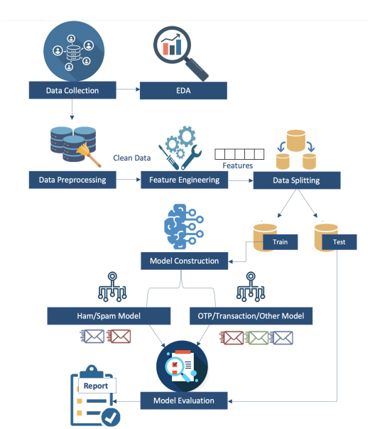
Proposed Methodology
Data Collection and Data Visualisation
Data Preprocessing
Feature Engineering
Data Splitting
Model Construction
Model Evaluation

Slide 8
Data Collection
Data collection is an important step in the process of model construction . Many datasets were available throughout the internet, but most of them were conversations from the US and UK. There were no datasets that are concerned with Indian SMS and how things work in India.
As we all know in India there are a variety of ways to spam people through SMS. We get random messages saying that we have won 10,000/- and to claim it we need to click a link or we are pre-approved for a loan. Taking into account all the types of different messages we have curated a dataset keeping the Indian scenario in mind. This is a unique dataset and created from scratch and contains more than 3000 data points.

Slide 9
Detecting Languages and Translating to English
We have used lingua-language detector for building the model to detect the languages we use.
!pip install lingua-language-detector
And also we used python Library for Translating the text
!pip install googletrans==4.0.0-rc1
Actual Text : మీ జియో నంబర్ 8919466484 పై 1 GB హై స్పీడ్ ఇంటర్నెట్ డేటా నుంచి 16-Jan-18 17:00 Hrs నాటికి 50% ఉపయోగించారు. మీ బ్యాలన్స్ మరియు వినియోదం ట్రాక్ చేయడానికి http://tiny.jio.com/TrackBalance లింక్ ను క్లిక్ చేయండి లేదా sms ద్వారా తెలుసుకొనుటకు 1299 మీద మిస్స్ డ్ కాల్ ఇవ్వండి.
Translated Text : About 50% from 1 GB High Speed Internet data on your Geo Number 8919466484 as 16-JAN-18 17:00 hrs.Click http://tiny.jio.com/trackbalance link to track your balance and consumption or give a misss on 1299 to learn via SMS.

Slide 10
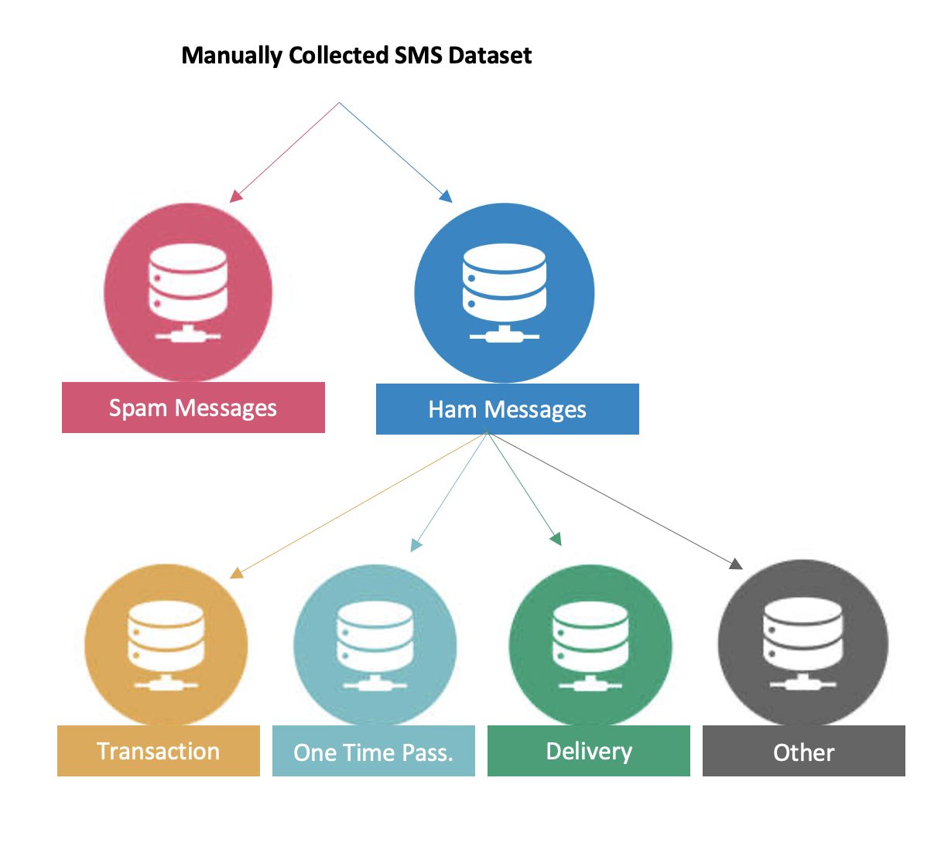
Data Visualization
Dataset Distribution

Slide 11
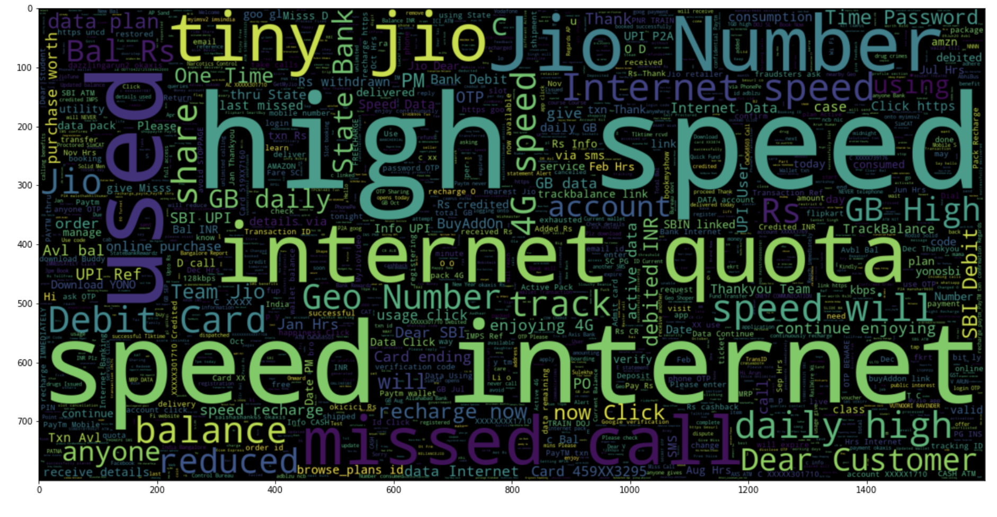
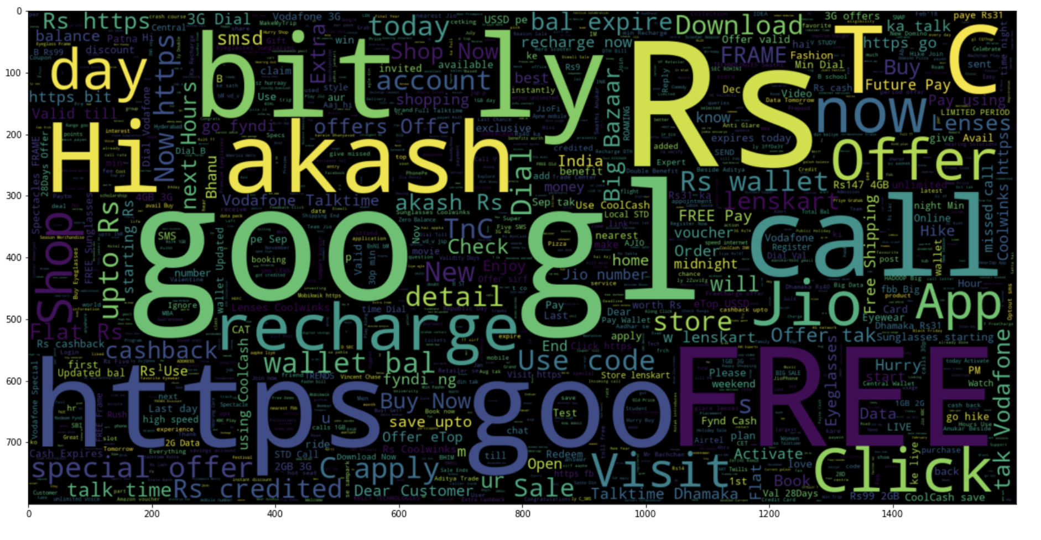
Ham / Spam Word Cloud
Ham
Spam

Slide 12
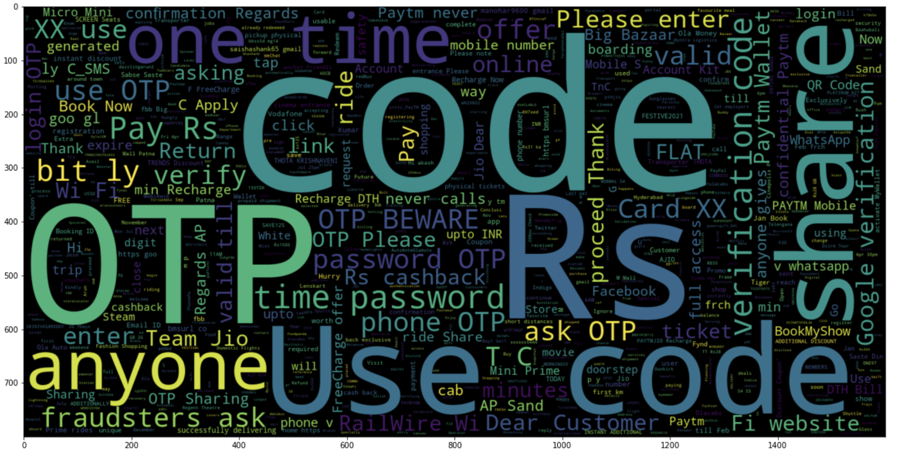
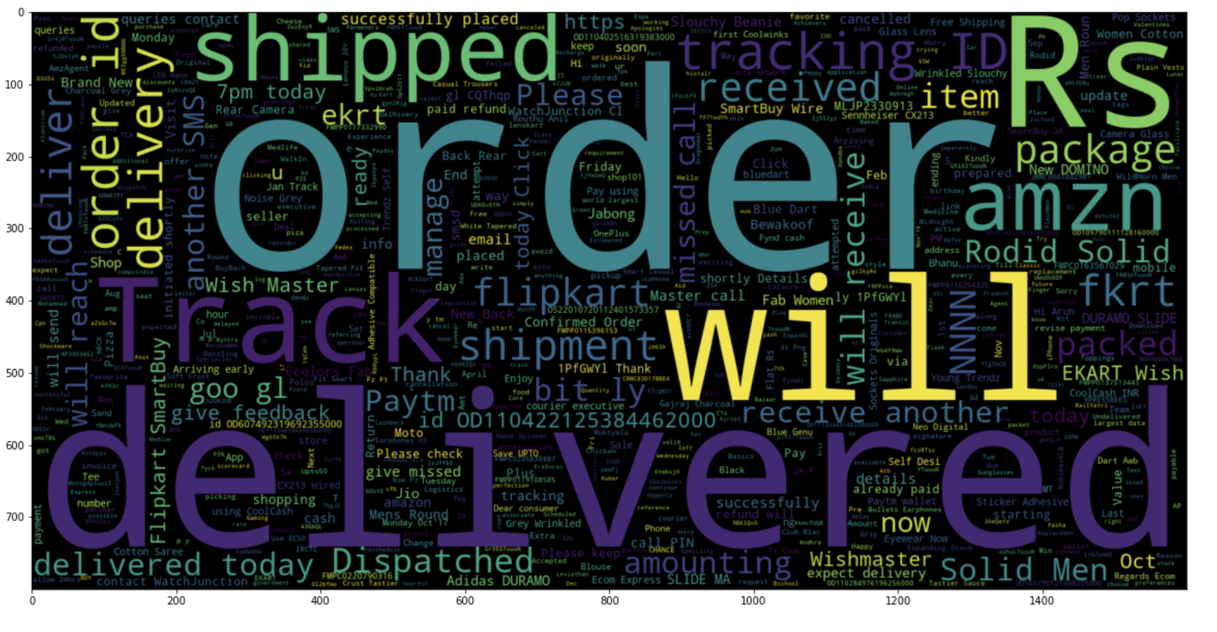
Labels(OTP, delivery, personal, tranasaction) Word Cloud
OTP
delivery

Slide 13
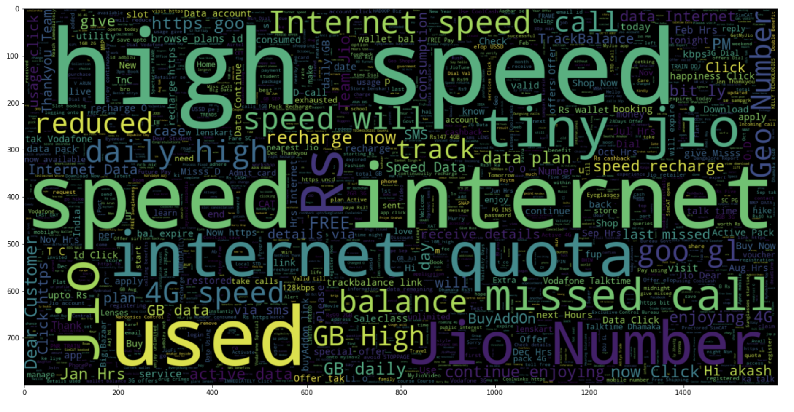
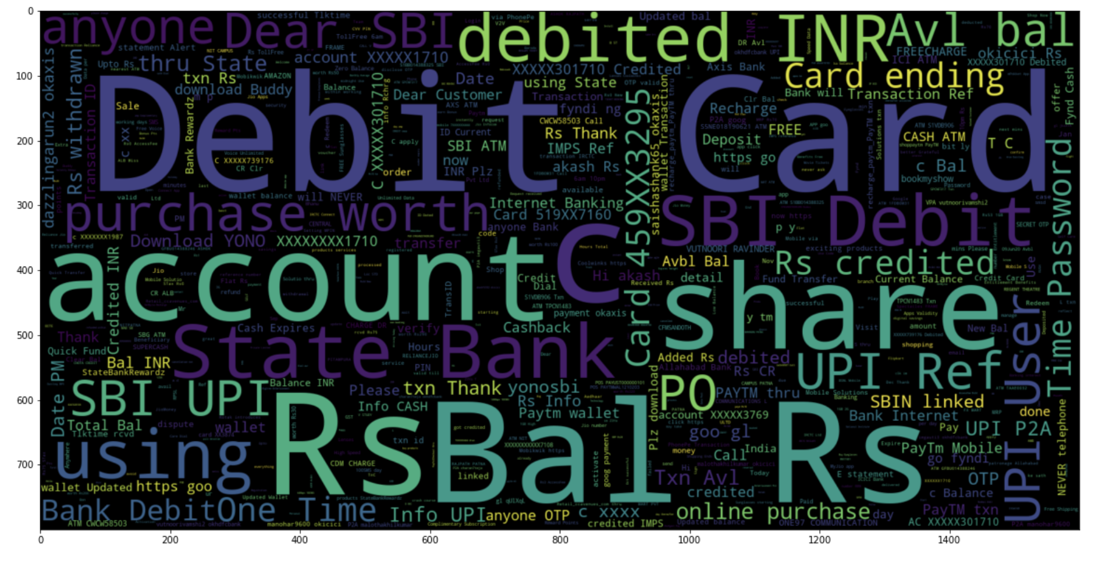
Labels(OTP, delivery, personal, tranasaction) Word Cloud
personal
transaction

Slide 14
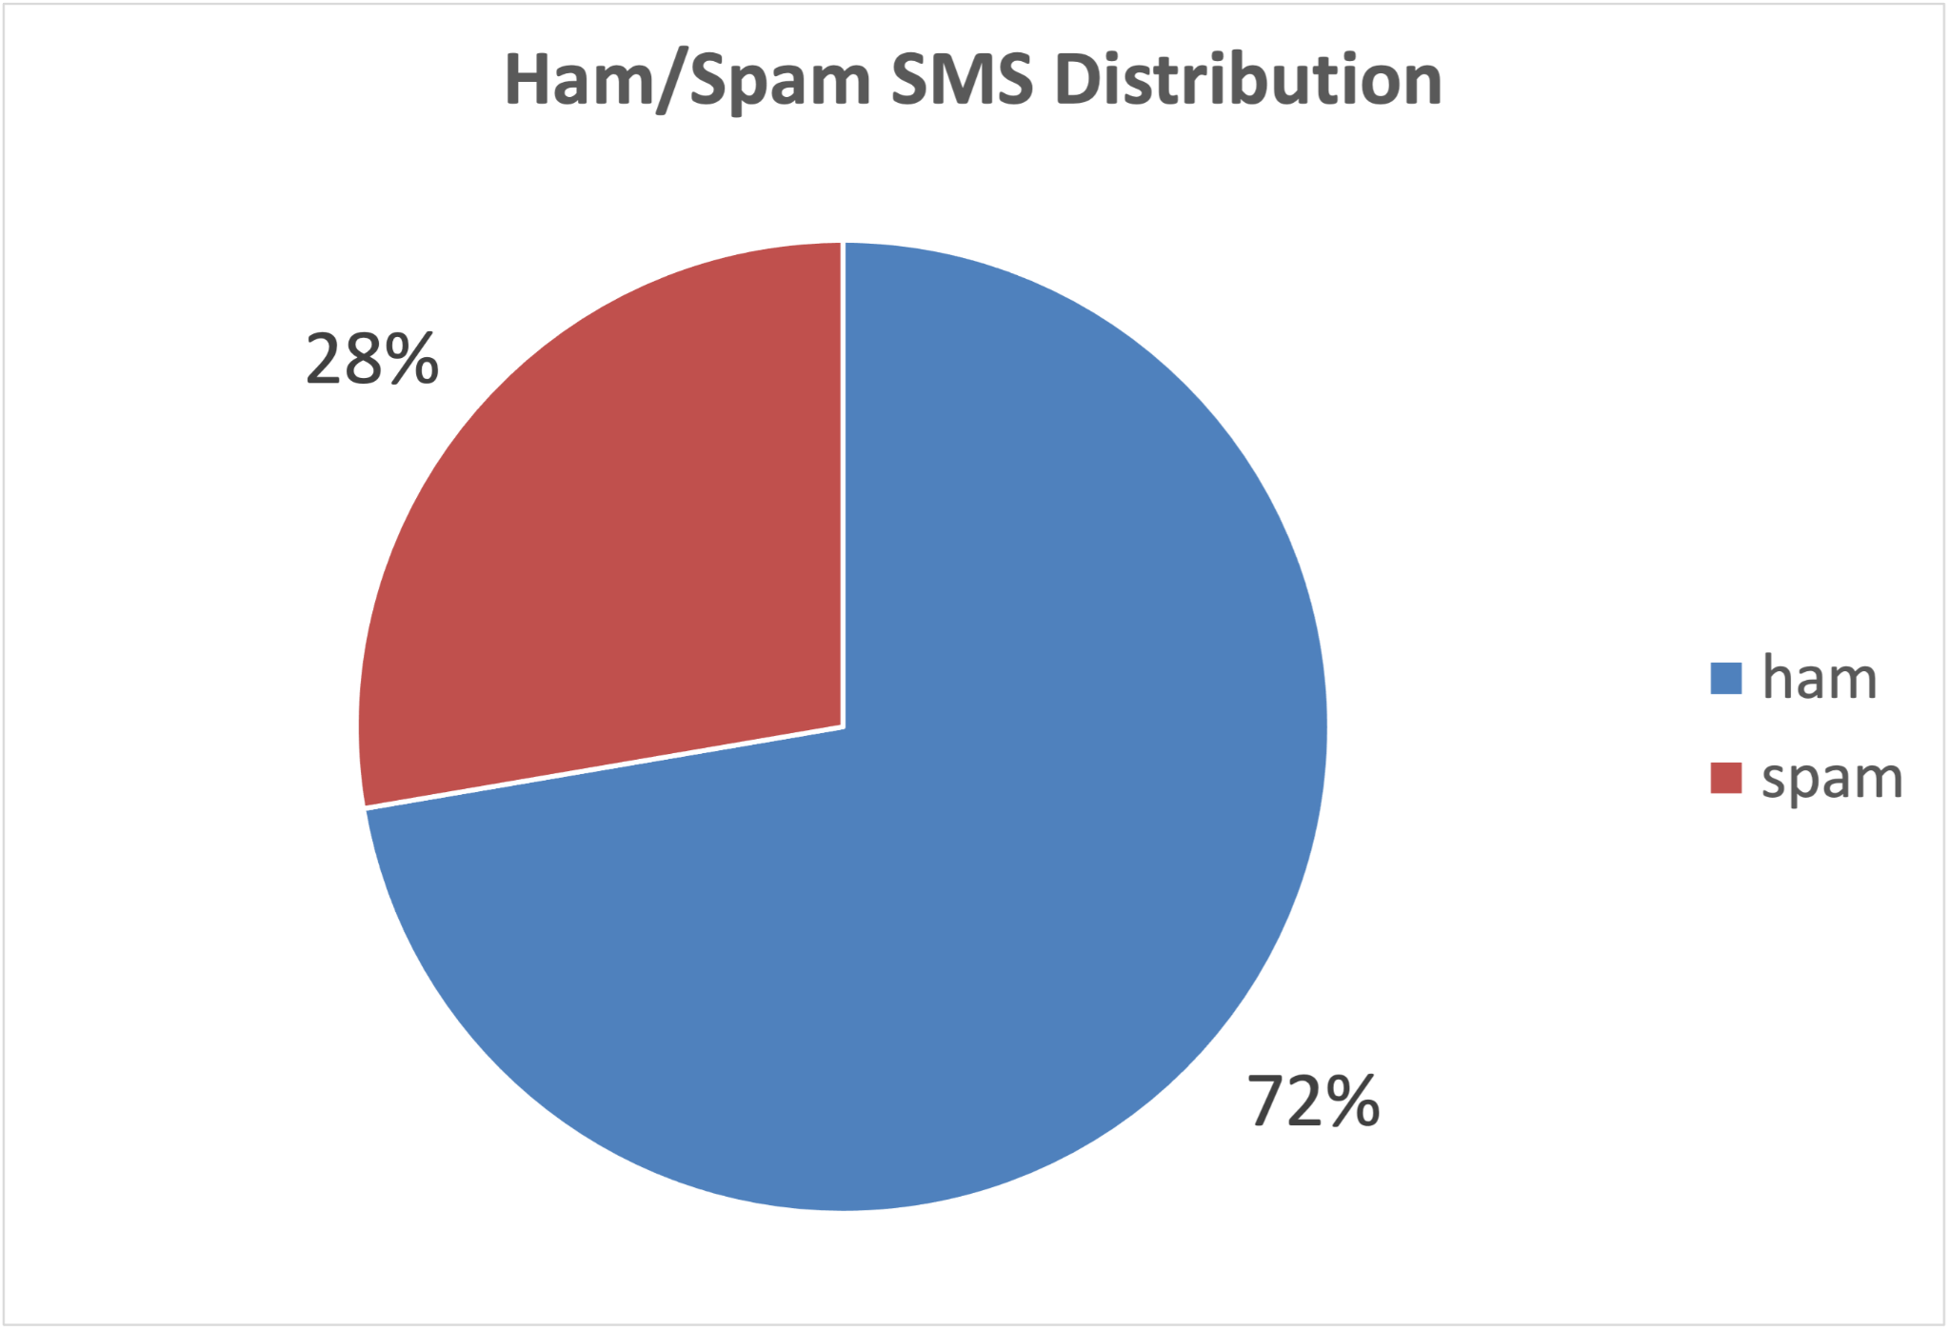
Ham / Spam Distribution

Slide 15
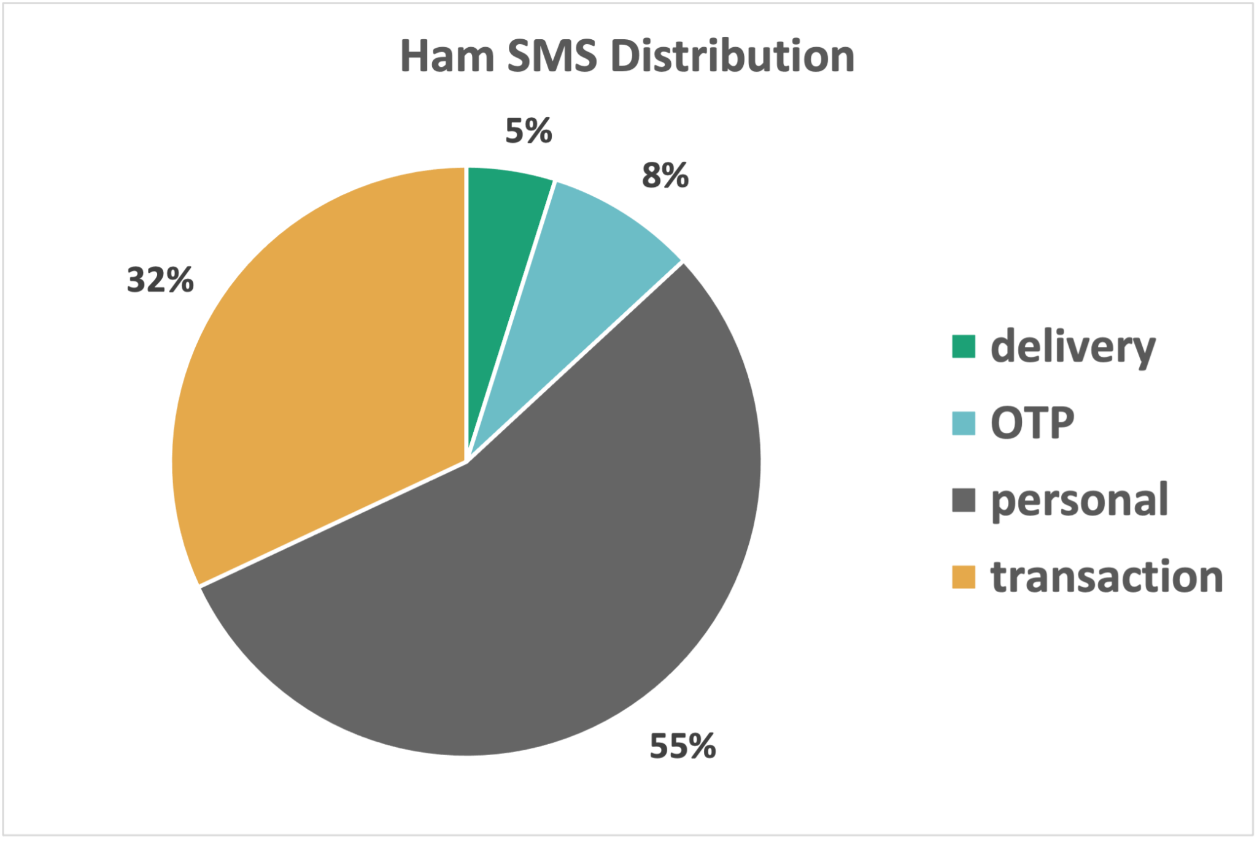
Labels from ham Distribution

Slide 16
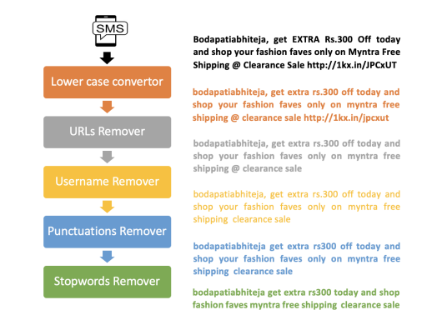
Pre-processing
Preprocessing is a data mining technique that transforms raw data into an understandable format. Real-world data is always incomplete and that data cannot be sent through a model. That would cause certain errors. That is why we need to preprocess data before sending it through a model.

Slide 17
Feature Engineering
In machine learning, the predictive models do not understand the predictive rules from the raw data. These models work on numerical vectors to understand the predictive rules. In machine learning, feature engineering is an essential step by converting texts into numbers and also conserving linguistic information for analysis. This step extracts the features from raw data and represent these features are a numeric vector. In this study, we have used following feature engineering techniques
Count Vectorization
TF-IDF

Slide 18
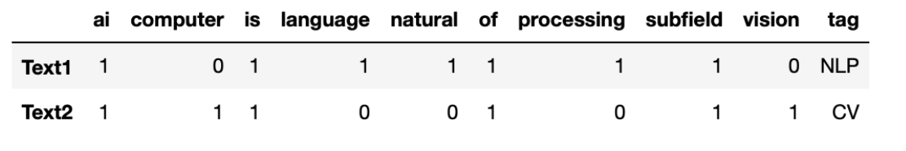
Count Vectorisation
Count Vectorizer is a way to convert a given set of strings into a frequency representation.
Lets look into this example:
Text1 = “Natural Language Processing is a subfield of AI”
tag1 = "NLP"
Text2 = “Computer Vision is a subfield of AI”
tag2 = "CV"
Count Vectors can be helpful in understanding the type of text by the frequency of words in it.

Slide 19
Term Frequency and Inverse Document Frequency
This is a statistic that is based on the frequency of a word in the corpus but it also provides a numerical representation of how important a word is for statistical analysis.
TF-IDF is better than Count Vectorizers because it not only focuses on the frequency of words present in the corpus but also provides the importance of the words.
We can then remove the words that are less important for analysis, hence making the model building less complex by reducing the input dimensions.

Slide 20
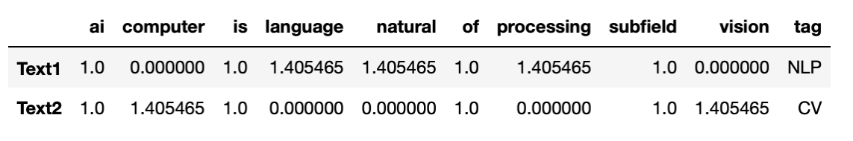
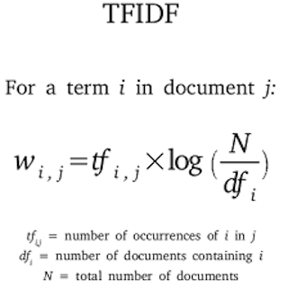
TF-IDF
TFIDF is based on the logic that words that are too abundant in a corpus and words that are too rare are both not statistically important for finding a pattern.
The Logarithmic factor in tfidf mathematically penalizes the words that are too abundant or too rare in the corpus by giving them low tfidf scores.
Higher value of tfidf signifies higher importance of the words in the corpus while lower values represent lower importance.

Slide 21
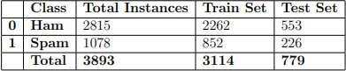
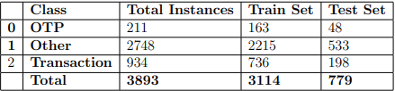
Data Splitting
In machine-learning, splitting data into train and test data is commonly used approach before model construction. Train data would be used by model to learn the classification rules. However, test data used for model evaluation. In this study, we used the Pareto Principle to split the given data i.e., ”80% of effects come from 20% of causes” This principle is also known as 80:20 ratio. Using this principle, 80% and 20% of data will be used for training and testing, respectively

Slide 22
Model Construction
We have Constructed Many models for different aspects of the use case
Models for Ham/Spam Classification and Classification of Labels from Ham classification by the model
Logistic Regression
Naive Bayes
Random Forest
SVM
Ensemble

Slide 23
Logistic Regression Model
It comes under the Supervised Learning technique. It is used for predicting the categorical dependent variable using a given set of independent variables.
It predicts the output of a categorical dependent variable and gives the probabilistic values which lie between 0 and 1.
Here instead of fitting a regression line, we fit an "S" shaped logistic function, which predicts two maximum values (0 or 1).
The curve from the logistic function indicates the likelihood of something such as whether the cells are cancerous or not, a mouse is obese or not based on its weight, etc.
Logistic Regression is a significant machine learning algorithm because it has the ability to provide probabilities and classify new data using continuous and discrete datasets.

Slide 24
Naive Bayes
It is a supervised learning algorithm, which is based on Bayes theorem and used for solving classification problems.
It is mainly used in text classification that includes a high-dimensional training dataset.
It is one of the simple Classification algorithms which helps in building the fast machine learning models that can make quick predictions.
It is a probabilistic classifier, which means it predicts on the basis of the probability of an object.

Slide 25
Random Forest
It belongs to the supervised learning technique.
It can be used for both Classification and Regression problems in ML.
It is based on the concept of ensemble learning, which is a process of combining multiple classifiers to solve a complex problem and to improve the performance of the model.
Random Forest is a classifier that contains a number of decision trees on various subsets of the given dataset and takes the average to improve the predictive accuracy of that dataset. Instead of relying on one decision tree, the random forest takes the prediction from each tree and based on the majority votes of predictions, and it predicts the final output.
The greater number of trees in the forest leads to higher accuracy and prevents the problem of overfitting.
It takes less training time as compared to other algorithms.
It predicts output with high accuracy, even for the large dataset it runs efficiently.
It can also maintain accuracy when a large proportion of data is missing

Slide 26
Support Vector Machine (SVM)
It comes under Supervised Learning algorithms, which is used for Classification as well as Regression problems.
The goal of the SVM algorithm is to create the best line or decision boundary that can segregate n-dimensional space into classes so that we can easily put the new data point in the correct category in the future. This best decision boundary is called a hyperplane.
SVM chooses the extreme points/vectors that help in creating the hyperplane. These extreme cases are called as support vectors, and hence algorithm is termed as Support Vector Machine.
SVM can be of two types:
Linear SVM: Linear SVM is used for linearly separable data, which means if a dataset can be classified into two classes by using a single straight line, then such data is termed as linearly separable data, and classifier is used called as Linear SVM classifier.
Non-linear SVM: Non-Linear SVM is used for non-linearly separated data, which means if a dataset cannot be classified by using a straight line, then such data is termed as non-linear data and classifier used is called as Non-linear SVM classifier.

Slide 27
Ensemble
Ensemble modeling is a process where multiple diverse models are created to predict an outcome, either by using many different modeling algorithms or using different training data sets.
They combine the decisions from multiple models to improve the overall performance.
Here we used Voting Classifier Ensembler with hard voting. that trains on an ensemble of numerous models and predicts an output (class) based on their highest probability of chosen class as the output.
In Ensemble we used LR, SVM, RFC as combined Machine Learning Models

Slide 28
Evaluation Metrics for Classification
Confusion Matrix
Precision - What percent of your predictions were correct?
Recall - What percent of the positive cases did you catch?
F1-Score - What percent of positive predictions were correct?
Support -

Slide 29
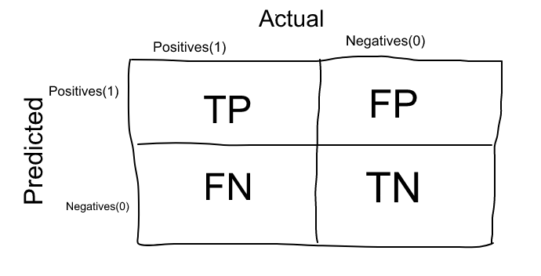
Confusion Matrix
The Confusion matrix is one of the most intuitive and easiest metrics used for finding the correctness and accuracy of the model.
It is used for Classification problem where the output can be of two or more types of classes.

Slide 30
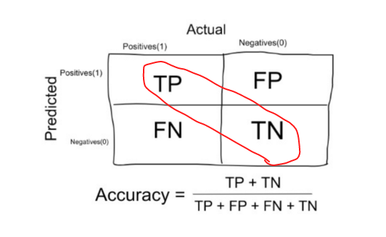
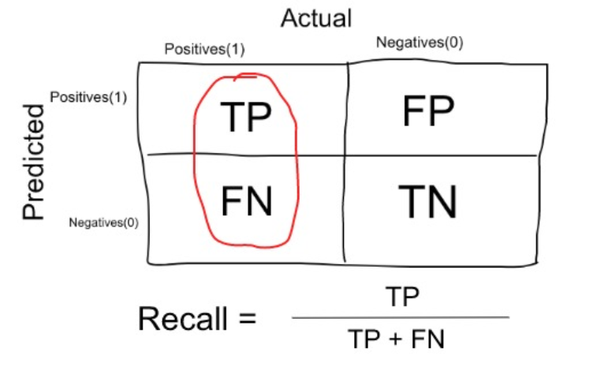
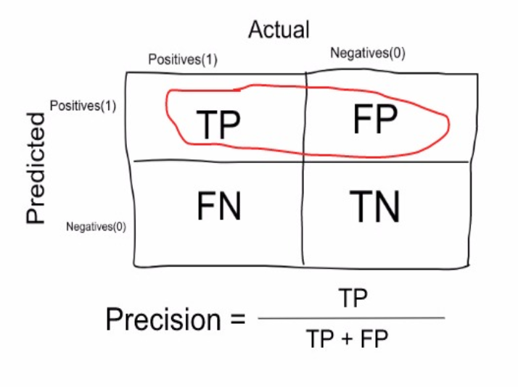
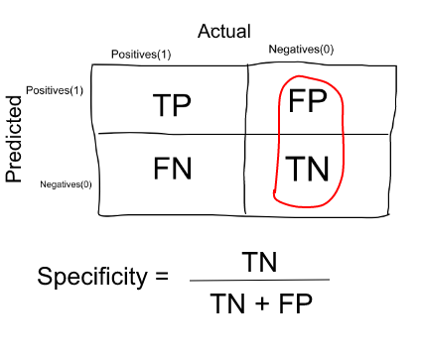
Accuracy
Recall
Precision
Specificity

Slide 31
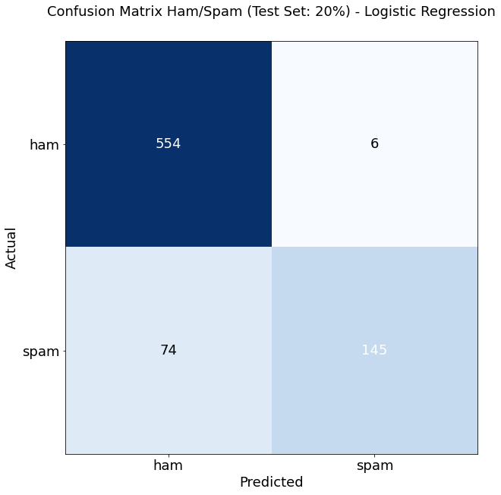
Model Evaluation - Ham/Spam Classification
Logistic Regression
Accuracy : 0.8973042362002568
Classification Report:
precision recall f1-score support
ham 0.88 0.99 0.93 560
spam 0.96 0.66 0.78 219
accuracy 0.90 779
macro avg 0.92 0.83 0.86 779
weighted avg 0.90 0.90 0.89 779

Slide 32
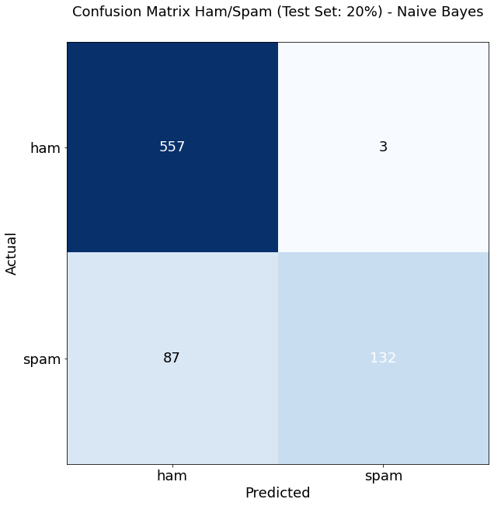
Model Evaluation - Ham/Spam Classification
Naive Bayes
Accuracy : 0.8844672657252889
Classification Report:
precision recall f1-score support
ham 0.86 0.99 0.93 560
spam 0.98 0.60 0.75 219
accuracy 0.88 779
macro avg 0.92 0.80 0.84 779
weighted avg 0.90 0.88 0.87 779

Slide 33

Model Evaluation - Ham/Spam Classification
Random Forest
Accuracy : 0.9165596919127086
Classification Report:
precision recall f1-score support
ham 0.91 0.99 0.94 560
spam 0.95 0.74 0.83 219
accuracy 0.92 779
macro avg 0.93 0.86 0.89 779
weighted avg 0.92 0.92 0.91 779

Slide 34
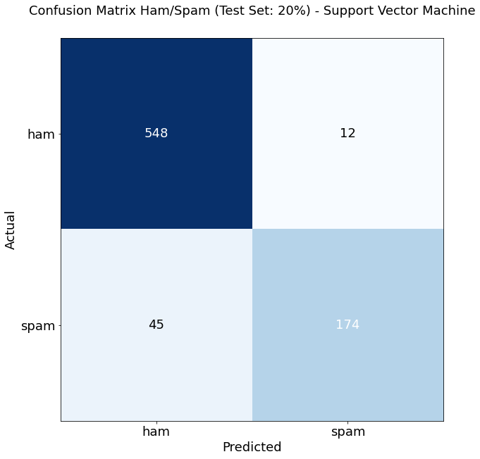
Model Evaluation - Ham/Spam Classification
Support Vector Machine (SVM)
Accuracy : 0.926829268292683
Classification Report:
precision recall f1-score support
ham 0.92 0.98 0.95 560
spam 0.94 0.79 0.86 219
accuracy 0.93 779
macro avg 0.93 0.89 0.90 779
weighted avg 0.93 0.93 0.92 779

Slide 35
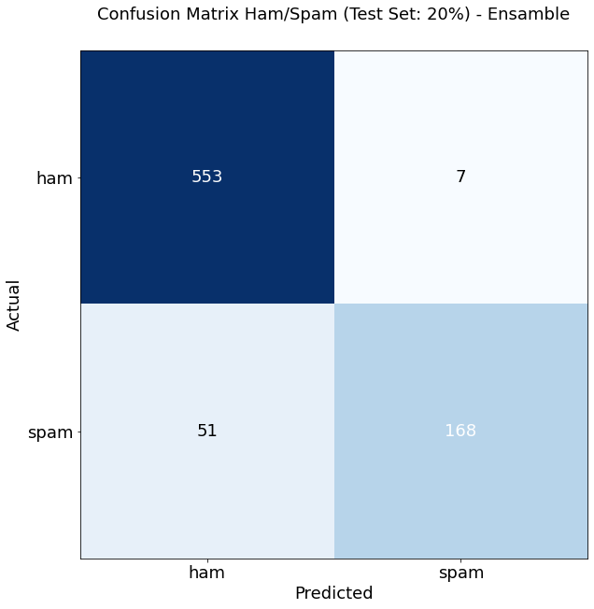
Model Evaluation - Ham/Spam Classification
Ensamble
Accuracy : 0.9255455712451861
Classification Report:
precision recall f1-score support
ham 0.92 0.99 0.95 560
spam 0.96 0.77 0.85 219
accuracy 0.93 779
macro avg 0.94 0.88 0.90 779
weighted avg 0.93 0.93 0.92 779

Slide 36
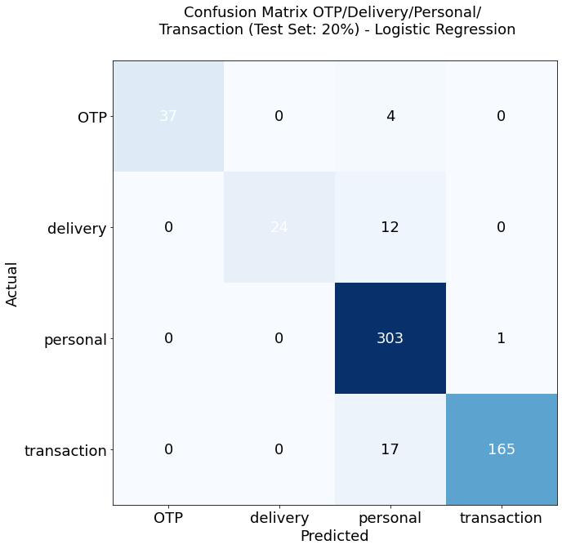
Model Evaluation - Label Classification
Logistic Regression
Accuracy : 0.9396092362344582
Classification Report:
precision recall f1-score support
OTP 1.00 0.90 0.95 41
delivery 1.00 0.67 0.80 36
personal 0.90 1.00 0.95 304
transaction 0.99 0.91 0.95 182
accuracy 0.94 563
macro avg 0.97 0.87 0.91 563
weighted avg 0.95 0.94 0.94 563

Slide 37
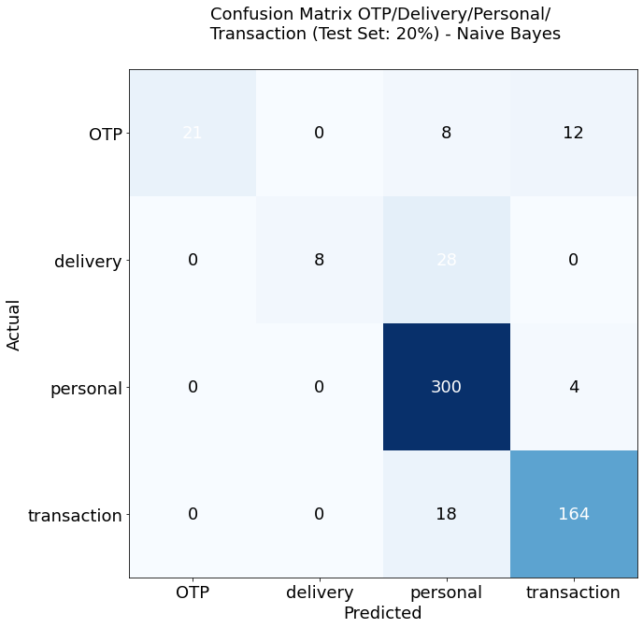
Model Evaluation - Label Classification
Naive Bayes
Accuracy : 0.8756660746003553
Classification Report:
precision recall f1-score support
OTP 1.00 0.51 0.68 41
delivery 1.00 0.22 0.36 36
personal 0.85 0.99 0.91 304
transaction 0.91 0.90 0.91 182
accuracy 0.88 563
macro avg 0.94 0.66 0.71 563
weighted avg 0.89 0.88 0.86 563

Slide 38
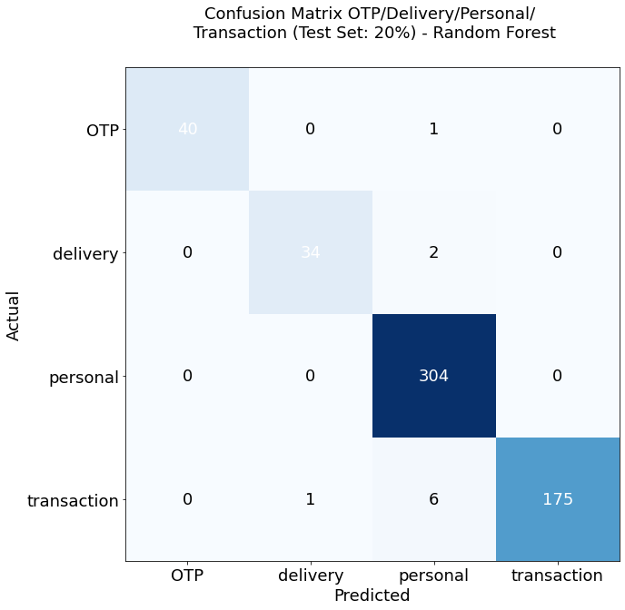
Model Evaluation - Label Classification
Random Forest
Random Forest : 0.9822380106571936
Classification Report:
precision recall f1-score support
OTP 1.00 0.98 0.99 41
delivery 0.97 0.94 0.96 36
personal 0.97 1.00 0.99 304
transaction 1.00 0.96 0.98 182
accuracy 0.98 563
macro avg 0.99 0.97 0.98 563
weighted avg 0.98 0.98 0.98 563

Slide 39

Model Evaluation - Label Classification
SVM
Support Vector Machine : 0.9662522202486679
Classification Report:
precision recall f1-score support
OTP 1.00 0.95 0.97 41
delivery 0.94 0.89 0.91 36
personal 0.95 1.00 0.97 304
transaction 0.99 0.93 0.96 182
accuracy 0.97 563
macro avg 0.97 0.94 0.96 563
weighted avg 0.97 0.97 0.97 563

Slide 40

Model Evaluation - Label Classification
Ensemble
Ensamble : 0.9680284191829485
Classification Report:
precision recall f1-score support
OTP 1.00 0.98 0.99 41
delivery 0.94 0.89 0.91 36
personal 0.95 1.00 0.97 304
transaction 1.00 0.93 0.96 182
accuracy 0.97 563
macro avg 0.97 0.95 0.96 563
weighted avg 0.97 0.97 0.97 563

Slide 41
Conclusion
This study used automated text classification techniques to detect ham and spam messages. Moreover, this study also compared five ML algorithms to classify messages as spam or ham. Additionally, the model B was also constructed to classify the ham messages into further four classes.
The experimental results showed that RFC, SVM, and ensemble algorithms achieved better classification results than LR and NB classifiers.
The SVM model outperformed with the accuracy of 93% for ham or spam classification. However for model B, RFC obtained the highest accuracy of 98%.
For future enhancement of work following guidelines are suggested and will be the direction of focus:
• Adding more data specific to Indian messages to improve the performance of the models
• Proposed methodology will be extended to incorporate deep neural networks.

Slide 42
References
[1] V. Cox, “Exploratory data analysis,” in Translating Statistics to Make Decisions. Springer, 2017, pp. 47–74.
[2] F. Heimerl, S. Lohmann, S. Lange, and T. Ertl, “Word cloud explorer: Text analytics based on word clouds,” in 2014 47th Hawaii international conference on system sciences. IEEE, 2014, pp. 1833–1842.
[3] S. Shaikh and S. M. Doudpotta, “Aspects based opinion mining for teacher and course evaluation,” Sukkur IBA Journal of Computing and Mathematical Sciences, vol. 3, no. 1, pp. 34–43, 2019.
[4] J. Ramos et al., “Using tf-idf to determine word relevance in document queries,” in Proceedings of the first instructional conference on machine learning, vol. 242, no. 1. Citeseer, 2003, pp. 29–48.
[5] R. Dunford, Q. Su, and E. Tamang, “The pareto principle,” 2014.
[6] Y.-C. Ho and D. L. Pepyne, “Simple explanation of the no-free-lunch theorem and its implications,” Journal of optimization theory and applications, vol. 115, no. 3, pp. 549–570, 2002.

Slide 43
References
[7] L. M. Gladence, M. Karthi, and V. M. Anu, “A statistical comparison of logistic regression and different bayes classification methods for machine learning,” ARPN Journal of Engineering and Applied Sciences, vol. 10, no. 14, pp. 5947–5953, 2015.
8] D. D. Lewis, “Naive (bayes) at forty: The independence assumption in information retrieval,” in European conference on machine learning. Springer, 1998, pp. 4–15.
[9] T. Joachims, “Text categorization with support vector machines: Learning with many relevant features,” in European conference on machine learning. Springer, 1998, pp. 137–142.
[10] B. Xu, X. Guo, Y. Ye, and J. Cheng, “An improved random forest classifier for text categorization.” J. Comput., vol. 7, no. 12, pp. 2913– 2920, 2012.
[11] O. Sagi and L. Rokach, “Ensemble learning: A survey,” Wiley Interdisciplinary Reviews: Data Mining and Knowledge Discovery, vol. 8, no. 4, p. e1249, 2018.
[12] N. Seliya, T. M. Khoshgoftaar, and J. Van Hulse, “A study on the relationships of classifier performance metrics,” in 2009 21st IEEE international conference on tools with artificial intelligence. IEEE, 2009, pp. 59–66.

Slide 44
Thank You

